Slide 1
Customer Analysis – Year over Year Trends
April 2025 By: Samuel Fernandes

Slide 2
Executive Summary
Customer count remained stable YOY, but average Customer Worth dropped significantly (~40%).
Boots category experienced large customer growth, but spend per customer appears abnormal.
Core and Elite segments saw major declines in engagement and value.
New and Infrequent shoppers are growing and changing overall customer behavior.
Strategies must target recovery of high-value customers and guide new ones into value-driving departments.

Slide 3
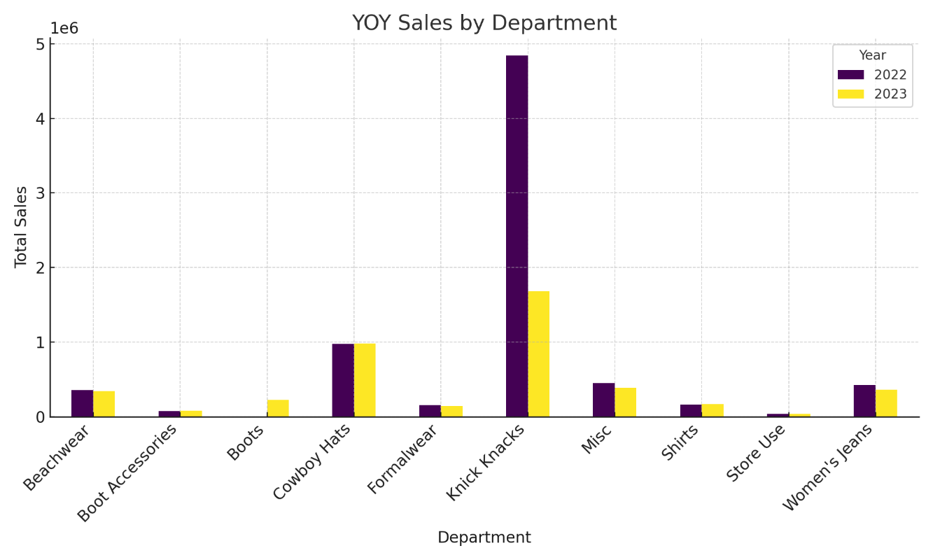
YOY Trends Overview
Total customer count: Stable YOY.
Customer Worth: Dropped ~40% – customers are spending less.
Department shifts:
- Boots and Accessories: Major growth in customers and sales.
- Knick Knacks: Lost over 67,000 customers and $3.2M in sales.

Slide 4
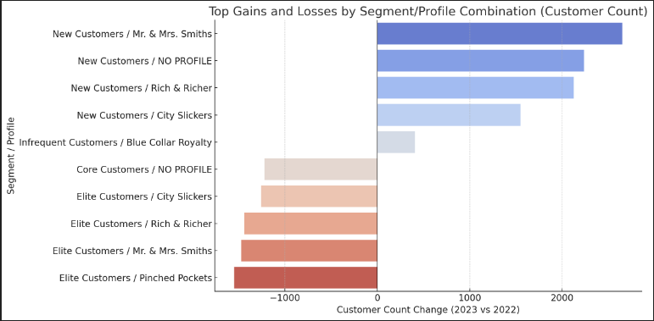
Segment and Profile Performance
Core and Elite segments lost the most high-value customers.
New and Infrequent segments grew significantly – especially in Boots category.
Profile-wise:
- 'Pinched Pockets' and 'Normal Families' lost most customers.
- Almost all profiles saw similar Customer Worth decline (±0.7%)
‘Pinched Pockets’ and Normal Families had an avg loss ~3.6%.

Slide 5
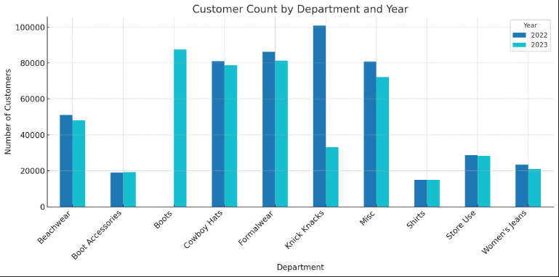
Customer Behavior Shift
Boots and Accessories saw massive growth in new customers (~90,000 net gain).
Spike suggests a temporary or seasonal trend – needs further validation.
Knick Knacks exodus drove revenue drop (~$4.8M to $1.6M).
New customers are not yet spending much on other departments.

Slide 6
Strategic Implications
Significant financial implication attached to losing high-value customers (Core/Elite customers).
New and Infrequent segments represent opportunity but require nurturing.
Profile stagnation suggests need for re-engagement and targeted strategies.
Profile shifts did not affect spending behavior.

Slide 7
Strategic Recommendations
Re-engage Core and Elite customers via loyalty campaigns or win-back offers.
Create onboarding and education campaigns for New/Infrequent shoppers.
Promote cross-category bundles (e.g., Knick Knacks + Boots) to increase AOV.
Monitor Boots anomaly – validate data and assess sustainability of trend.
Track shifts monthly to preempt major behavioral changes.

Slide 8
Data & Caution Notes
Anomalies observed:
- 97 customers in Boots category with only $0.20 spend.
- Large growth in customer count with relatively low revenue.
Assumed data is directionally correct unless noted.

